Slide 1


Dependency Injection
Ivan Lazarević

Slide 2


What is DI?
Wikipedia

Slide 3


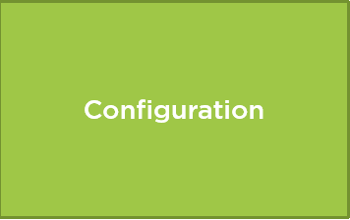


Runtime EF

Slide 4
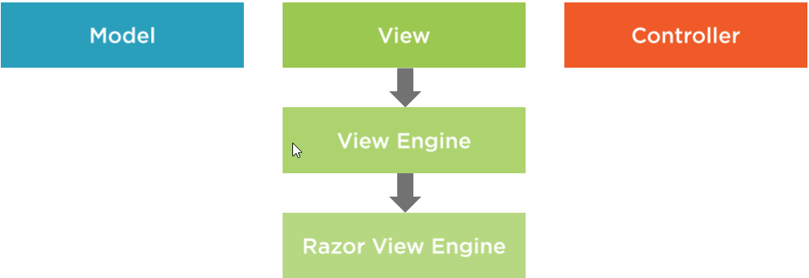
Razor

Slide 5
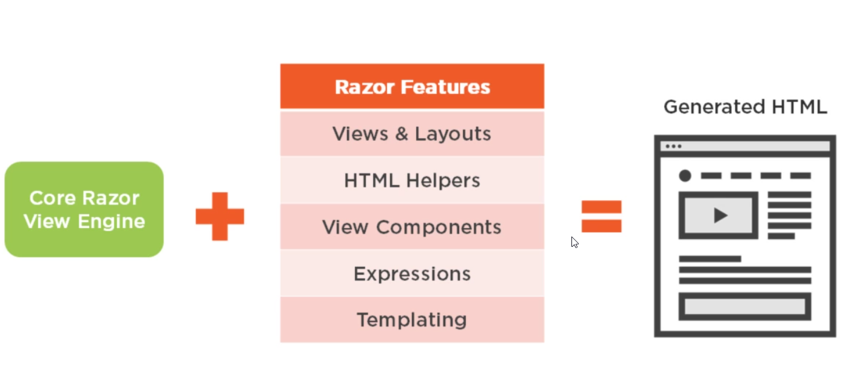
Razor

Slide 6
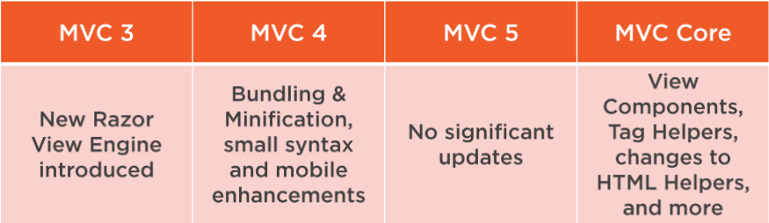
Razor

Slide 7
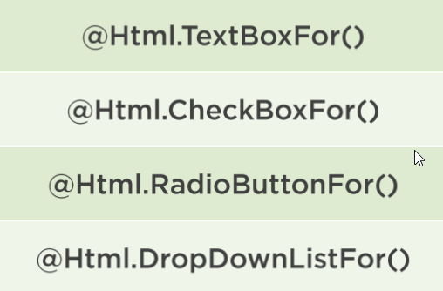
HTML Helpers

Slide 8
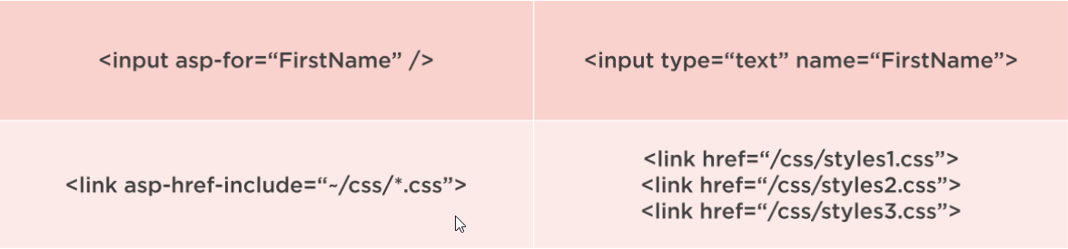
TagHelpers

Slide 9
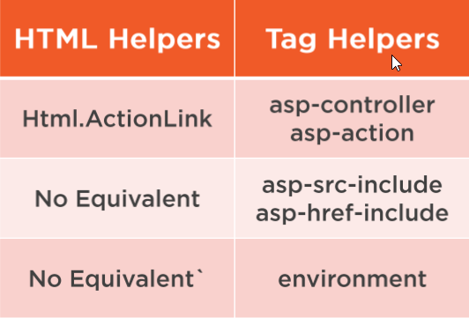
TagHelpers

Slide 10
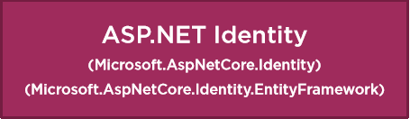


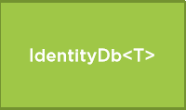

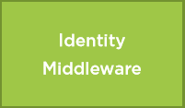
Identity Framework

Slide 11
Thank you for your attention

